Slide 1

Codebasics Resume Project
Challenge : Provide Insights to the Marketing Team in Food & Beverage Industry
Domain: F & B Function: Marketing

Slide 2

CodeX
CodeX is a German beverage company that is aiming to make its mark in the Indian market. A few months ago, they launched their energy drink in 10 cities in India.
Their Marketing team is responsible for increasing brand awareness, market share, and product development.
They conducted a survey in those 10 cities and received results from 10k respondents.

Slide 3
Primary Insights
objective
Peter Pandey, a marketing data analyst is tasked to convert these survey results to meaningful insights which the team can use to drive actions.
Secondary Insights
Resources Provided: Dataset required to generate Insights, Metadata & Survey questions
Tools Used: Microsoft Power BI (Data Cleaning, Data Modelling, Visualisation) &
Microsoft Power Point

Slide 4
Primary Insights
Demographic Insights
Consumer Preferences
Competition Analysis
Purchase Behavior
Marketing Channels & Brand Awareness
Brand Penetration
Product Development

Slide 5
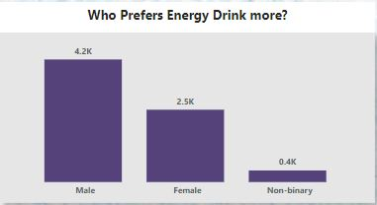
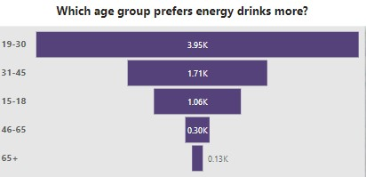
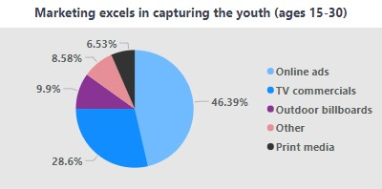
Demographic INSIGHTS
Among the demographic, around 4.2k males exhibit the greatest preference for energy drinks.
Energy drinks are predominantly favored by the 19-30 age group, which constitutes 3.95k individuals, while the preference among individuals above 65 is relatively limited.
Among different advertising channels, online ads and TV commercials are most successful in reaching the youth.

Slide 6
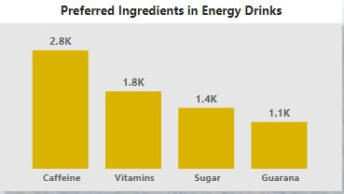
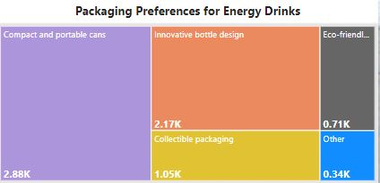
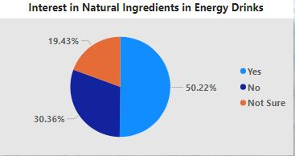
Consumer Preferences
The ingredient of choice in energy drinks is Caffeine, whereas Guarana is the least sought-after option among consumers.
Most consumers prefers compact and portable cans and also innovative bottle designs for energy drink packaging
Approximately half of the population of consumers has a preference for energy drinks that contain natural ingredients.

Slide 7
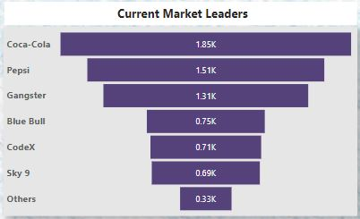
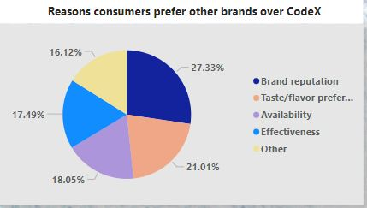
Competition analysis
Coca-Cola and Pepsi hold the position of current market leaders, while there is a significant segment of the population, approximately 0.71k people, who prefer CodeX.
Nearly 48% of the consumer base prioritizes brand reputation and their taste or flavor preferences associated with other brands over choosing CodeX.

Slide 8
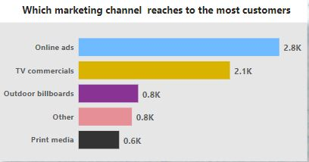
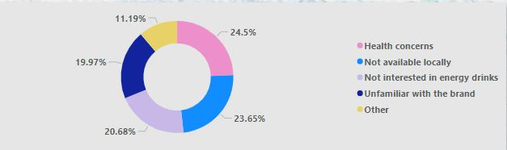
MARKETING CHANNELS AND BRAND AWARENESS
Online advertisements and television commercials have a reach of over 4.9k among customers.
Among the CodeX consumers, 20% of the people were not aware of the brand .

Slide 9
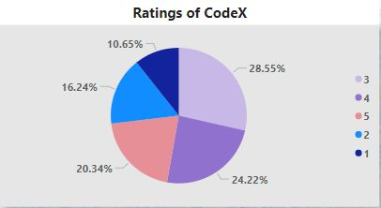
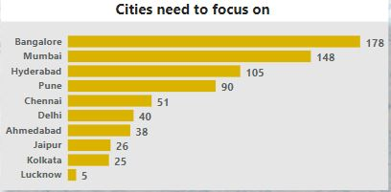
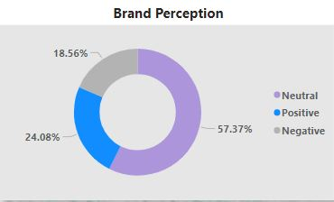
Brand penetration
Among those who preferred the CodeX brand, approximately 28.55% of consumers gave a 3-star rating, while around 24.22% of consumers gave a 4-star rating.
The majority of consumers who consume CodeX have a neutral perception of the brand.
Lucknow, Kolkata, and Jaipur are the cities that require greater attention and focus.
The brand penetration of CodeX is 9.8%.

Slide 10
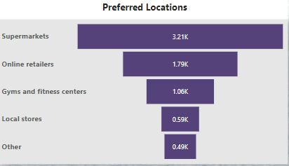
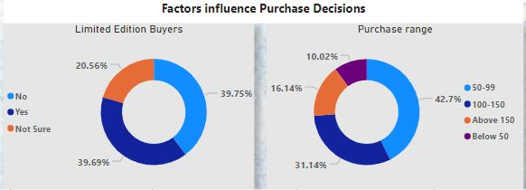
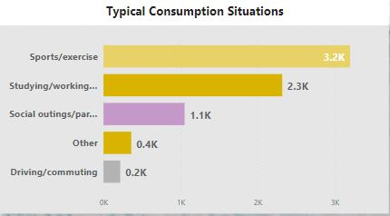
Purchase behavior
Around 3.21k respondents prefers to purchase energy drinks from Supermarkets
The common scenarios in which respondents typically consume energy drinks are during sports/exercise activities and while studying/working.
The proportion of customers who are limited edition buyers and those who are not are nearly equal.
Most respondents prefer product in price range (50-99).

Slide 11
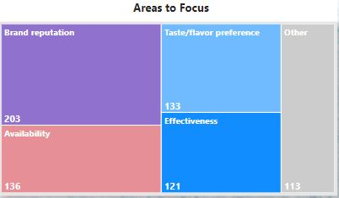
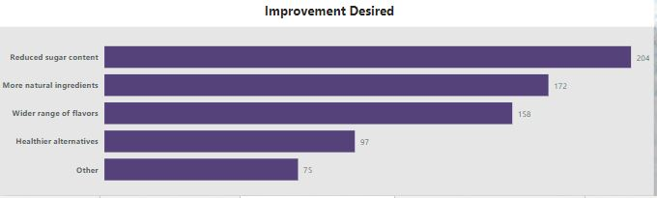
Product development
Areas to be focused on Product Development are Brand reputation and availability.
The sugar level can be reduced and more natural ingredients can be added in the drink for more product development.

Slide 12
Secondary insights
What immediate improvements can we bring to the Product?
What should be the ideal price of our product?
What kind of marketing campaigns, offers, and discounts we can run?
Who can be a brand ambassador, and why?
Who should be our target audience, and why?

Slide 13
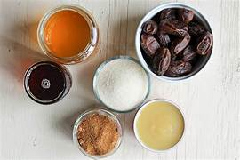
What immediate improvements can we bring to the Product?
Use real fruit extracts, natural sweeteners, and botanical extracts to enhance the taste profile of your energy drink.
Offer low or no sugar variations of your energy drink to cater to health-conscious consumers. Develop flavors that are naturally sweetened or use sugar substitutes that maintain the taste while reducing the overall sugar content.
Improve the visual appeal and functionality of your energy drink packaging.
Consider updating the logo, color scheme, and overall design to create eye-catching and memorable packaging.

Slide 14
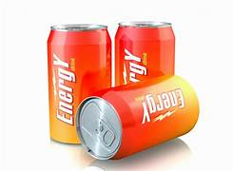
What should be the ideal price of our product?
The ideal price of the product should be lie in the range (50-150) to attract more customers as most customers prefer drinks in this range.

Slide 15
What kind of marketing campaigns, offers, and discounts we can run?
We can promote Codex energy drinks through sponsored posts, product reviews, or giveaways, reaching their followers and generating brand awareness.
Launch a referral program where customers can earn rewards for referring friends or family members to try Codex energy drinks.
Introduce a subscription service where customers can sign up for regular deliveries of Codex energy drinks. Offer discounted prices, exclusive flavors, or additional perks for subscribers. This helps secure recurring revenue and fosters long-term customer loyalty.

Slide 16
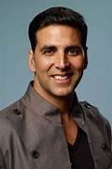
Who can be a brand ambassador, and why?
Akshay Kumar can be a strong choice as a brand ambassador for energy drinks due to his association with fitness, action-oriented roles, and commitment to a healthy lifestyle.

Slide 17

Who should be our target audience, and why?
Students and professionals, especially those in high-stress environments, are often targeted by energy drink brands.
Energy drinks often target young adults and millennials who lead busy and active lifestyles. This age group typically seeks quick energy boosts to enhance focus, and productivity, making them a prime audience for energy drink consumption.
The gaming community and e-sports enthusiasts are a growing target audience for energy drinks.

Slide 18
Thankyou to the codebasics team

